Slide 1
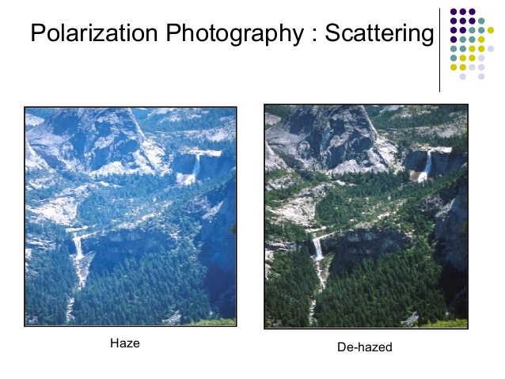
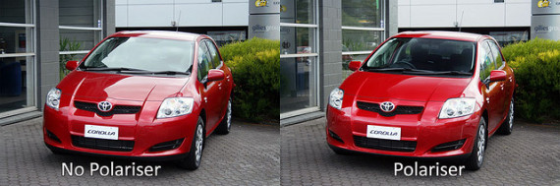
Polarization of light

Slide 2
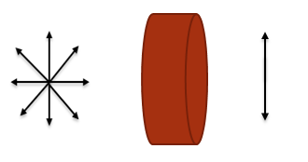
Basic Information:
Light
a transverse electromagnetic wave
Unpolarised Light
Polarised light
oscillation of electric field are occurring in all possible directions
oscillation of electric field are occurring in a particular direction
Unpolarised light
Polarised light
Polarizer

Slide 3
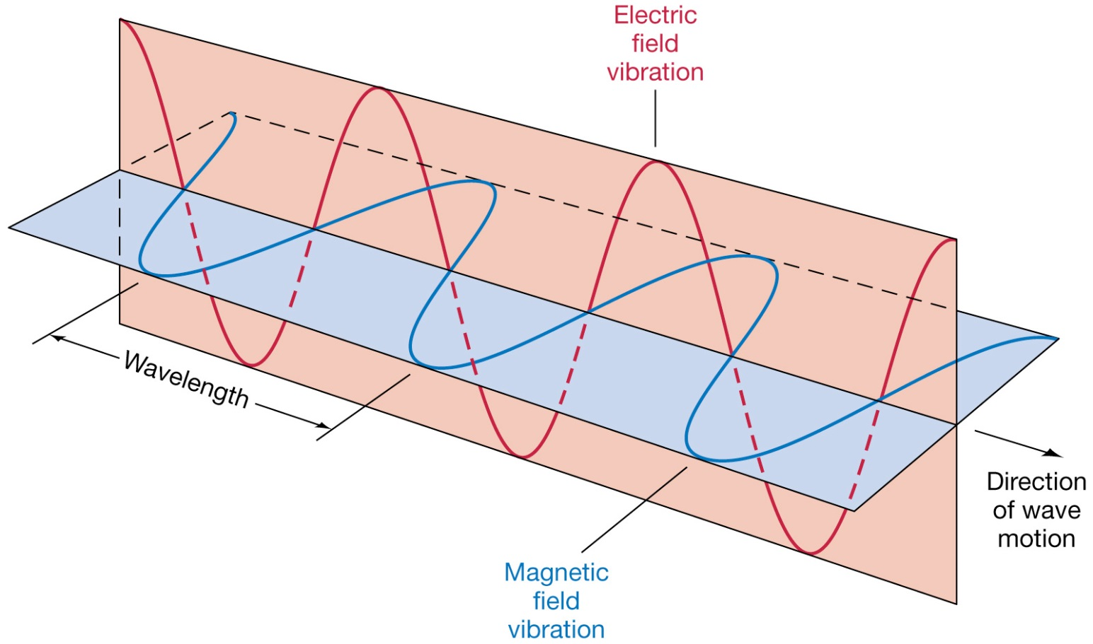
Polarization of EM wave
Direction of E-polarization
Light is considered polarized along Electric field
Unpolarized light has random polarization direction

Slide 4
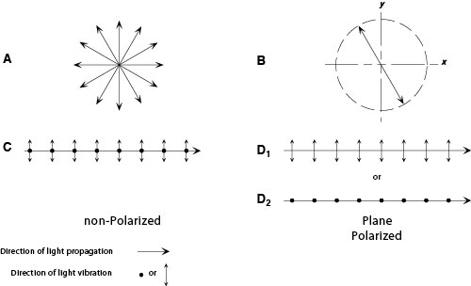
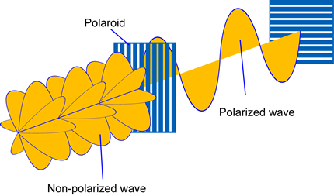
Polarizer: Polarized light
Polarizer or polaroid:
A system that allows one direction of E-vibration unperturbed
Allows other polarizations as well, but with reduced intensity

Slide 5
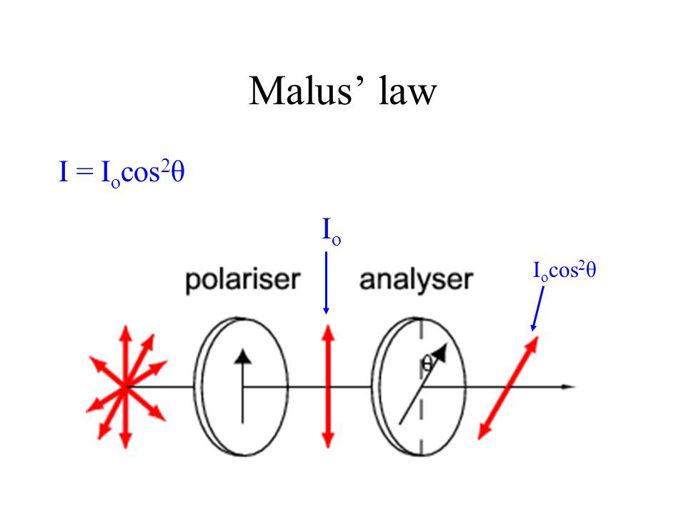
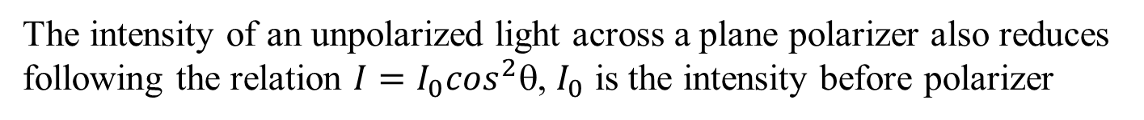
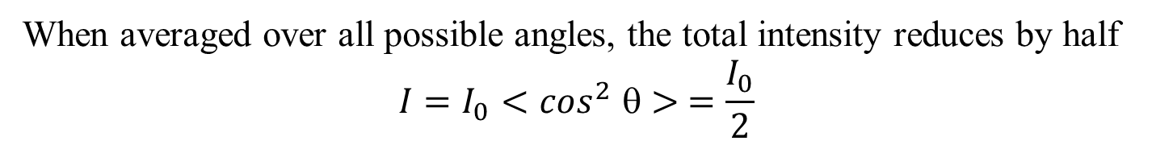
Malus’ Law
The 1st polarizer is used to polarize unpolarised light in a plane
The 2nd polarizer (analyzer) is rotated w.r.t. the 1st polarizer by an angle θ
Unloparised light through polariser
The intensity of an unpolarized light across a plane polarizer also reduces following the relation $I=I_{0}\cos^{2}θ$, $I_{0}$ is the intensity before polarizer
When averaged over all possible angles, the total intensity reduces by half
$$I=I_{0}{<cos}^{2}θ> =\frac{I_{0}}{2}$$

Slide 6
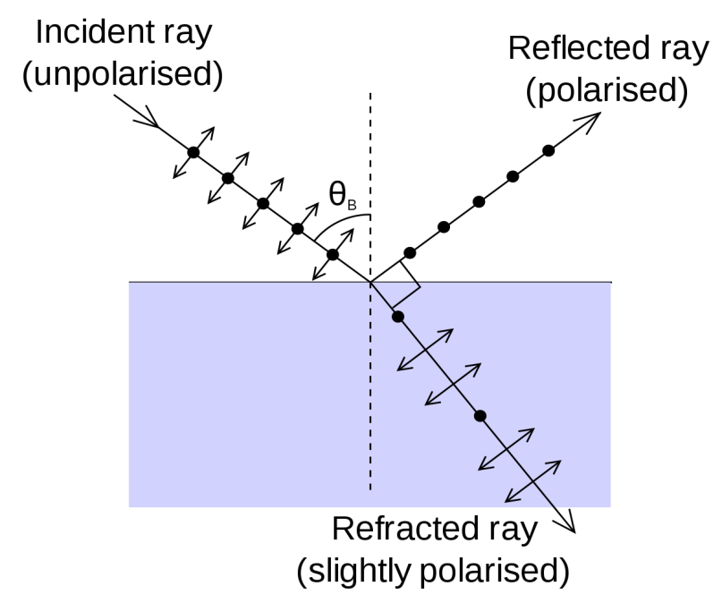
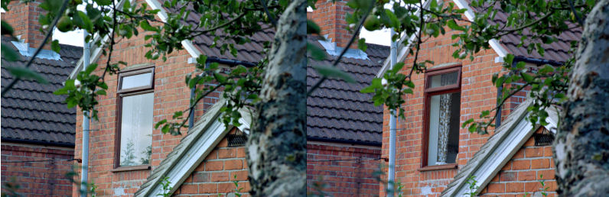
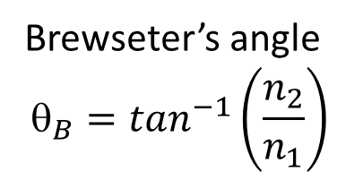
Polarization by reflection: Brewsters law
Brewseter’s angle
$$_{B}=\tan^{−1}\left(\frac{n_{2}}{n_{1}}\right)$$
n₁
n₂
At this angle of incident, a plane polarized light has zero reflection coefficient. So, for unpolarized incident light, the reflected ray will be plane polarized and refracted ray will be partially polarized
Look at the window!!

Slide 7
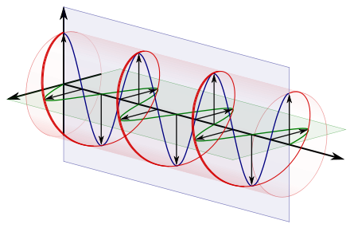
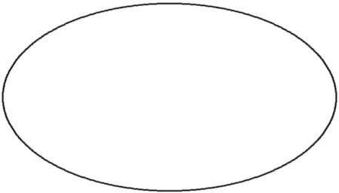
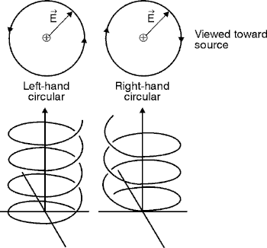
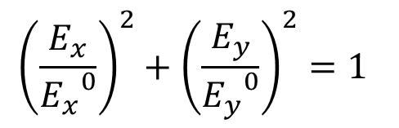
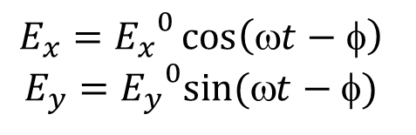
Superposition: elliptical and circularly polarized light
If light is composed of two plane waves of unequal amplitude by differing in phase by 90°, then the light is said to be elliptically polarized.
$$E_{x}={E_{x}}^{0}\cos\left(ωt−φ\right)$$
$$E_{y}={E_{y}}^{0}sin⁡(t−)$$
$${\left(\frac{E_{x}}{{E_{x}}^{0}}\right)}^{2}+{\left(\frac{E_{y}}{{E_{y}}^{0}}\right)}^{2}=1$$
And we have
Viewed towards source
When ${E_{x}}^{0}$=${E_{y}}^{0}$, we have special case of circularly polarized light

Slide 8
Right and left circularly polarized light
Depending on which of the x or y component is leading in phase, we might have right or left circular polarization
Elliptic and circularly polarized light can be produced from linearly polarized light when passed through a quarter wave plate

Slide 9
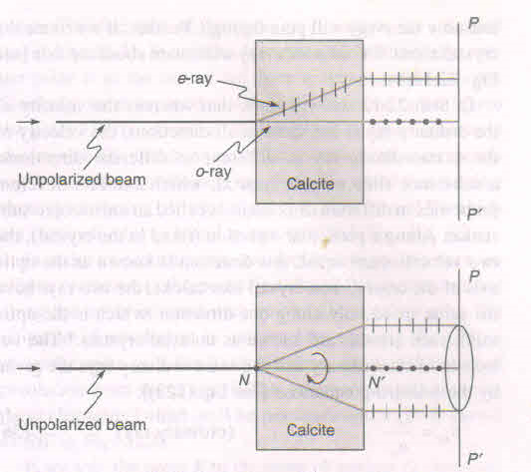
Polarizer crystal: Double refraction
y
z
.
x
Two polarised rays, namely ordinary (o-ray) and extraordinary (e-ray) is seen when unloparised light passes through a double refracting crystal
e-ray will rotate if the crystal is rotated
Origin of this is associated to the underlying electron distribution of those crystal structures
e-ray and o-ray has same velocity along one direction along the crystal known as optic axis

Slide 10
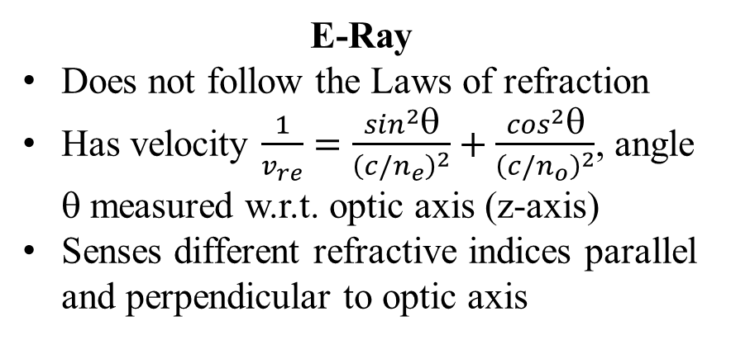
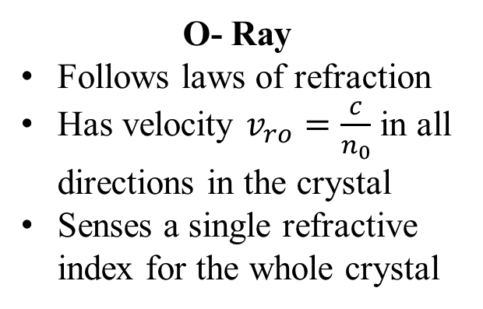
Ordinary and extraordinary light rays
O- Ray
Follows laws of refraction
Has velocity $v_{ro}=\frac{c}{n_{0}}$in all directions in the crystal
Senses a single refractive index for the whole crystal
E-Ray
Does not follow the Laws of refraction
Has velocity $\frac{1}{v_{re}}=\frac{\sin^{2}θ}{{\left(c/n_{e}\right)}^{2}}+\frac{\cos^{2}θ}{{\left(c/n_{o}\right)}^{2}}$, angle θ measured w.r.t. optic axis (z-axis)
Senses different refractive indices parallel and perpendicular to optic axis
The different velocities of e-ray along different directions produces phase shift. This can be used to:
Change polarization direction of a linearly polarized incident ray
Produce circularly polarized light from linearly polarized light and vice-versa

Slide 11
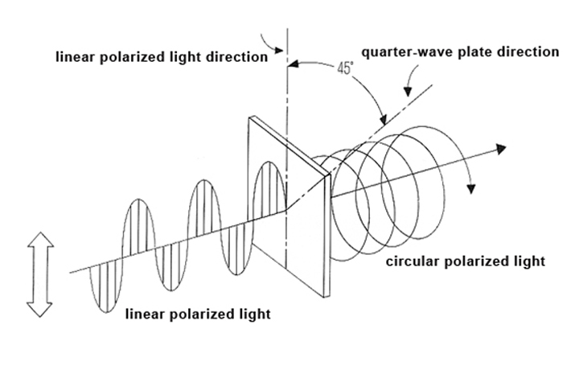
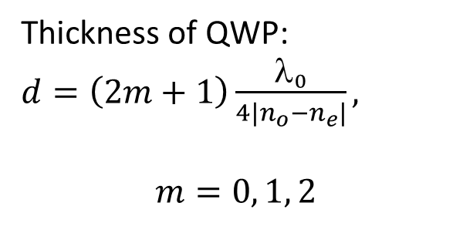
Waveplate
A waveplate is an optical device that alters the polarization state of a light wave travelling through it. Optic axis of a waveplate is parallel to its surface
Quarter wave plate (QWP):
Produces a phase difference of π/2 between two polarized components
Linear polarized beam becomes elliptically polarized across QWP
If the plane of polarization of the incident light makes and angle of 45º with optic axis, the output becomes circularly polarized
Thickness of QWP: $d=\left(2m+1\right)\frac{λ_{0}}{{4|n}_{o}−n_{e}|},$
$$m=0, 1, 2$$

Slide 12
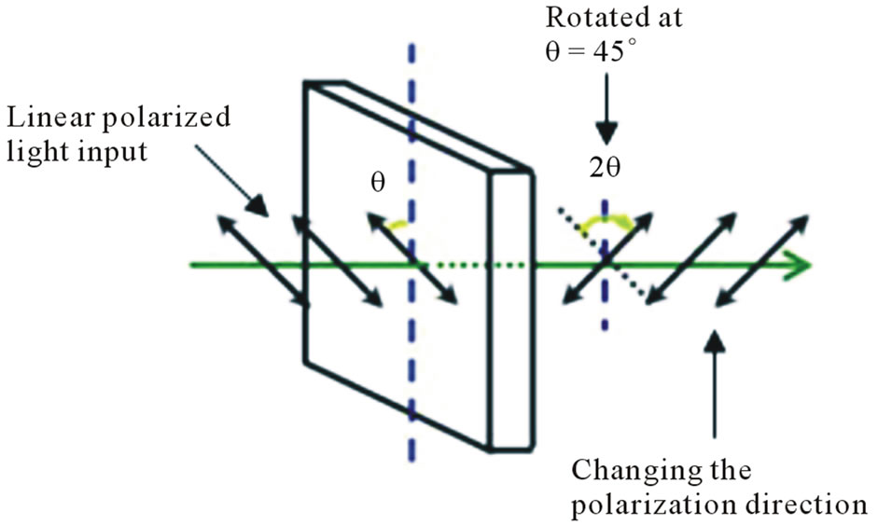
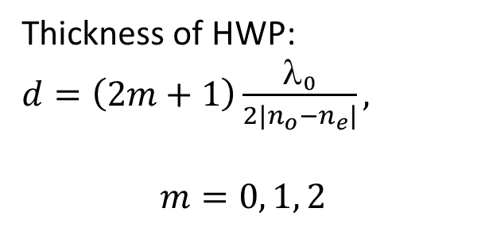
Waveplate
Half wave plate (HWP):
Produces a phase difference of π between two polarized components
Plane of linear polarized beam rotates by π/2 across HWP when incident in an angle of 45º with optic axis
A right circularly polarized light will be left circularly polarized and vice-versa across a HWP
Thickness of HWP: $d=\left(2m+1\right)\frac{λ_{0}}{{2|n}_{o}−n_{e}|},$
$$m=0, 1, 2$$

Slide 13
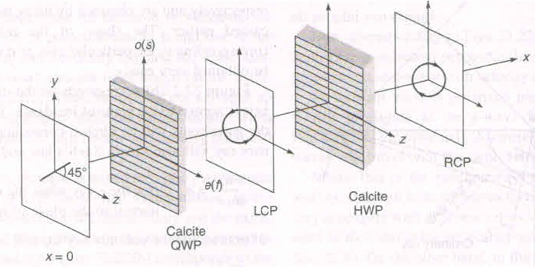
Waveplate
A combination of HWP and QWP can be used to produce different polarizations

Slide 14

Optical Activity
A substance is optically active if it rotates the plane of polarized light.
Dextrorotatory Substance
Rotation is clockwise
Example: Glyceraldehyde
Levorotatory Substance
Rotation is counterclockwise
Example: D-fructose
Specific rotation [S] of a chiral substance
the rotation produced by a column of solution of length L decimeter and containing 1 gm of the active substance per cm³ of the solution at a particular temperature, wavelength, and concentration (c)
Length (L) measured in cm.
θ is the angle of rotation.
$$S= \frac{10 θ}{L c}$$

Slide 15
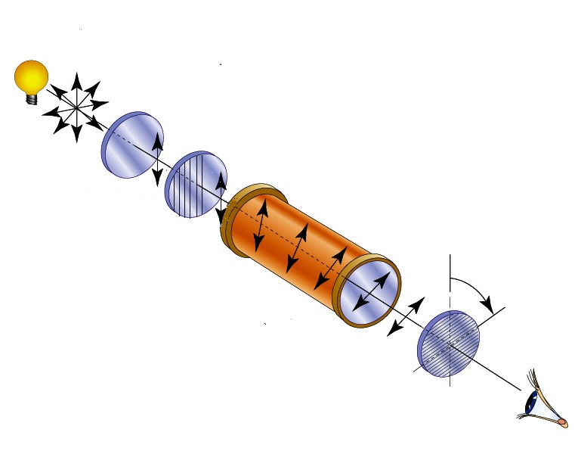

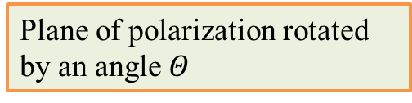
Experimental Setup
Unpolarized Light
Polarized Light
Monochromatic Light Source
Polarimeter tube
(optically active substance)
Polarizer
$$Θ$$
Half-shade Plate
Viewer
Plane of polarization rotated by an angle $Θ$
Analyzer

